Slide 1
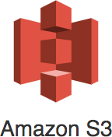

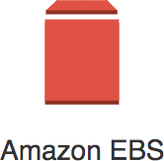

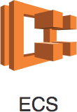
Getting Started
AWS has 200+ services. Exam expects you to understand 40+ services. Exam tests your decision making abilities:
Which service do you choose in which situation?
This course is designed to help you make these choices
Our Goal : Help you get certified and start your cloud journey with AWS

Slide 2

Amazon Web Services (AWS)
Leading cloud service provider Provides most (200+) services
Reliable, secure and cost-effective
The entire course is all about AWS. You will learn it as we go further.

Slide 3
Best path to learn AWS!
Cloud applications make use of multiple AWS services.
There is no single path to learn these services independently. HOWEVER, we've worked out a simple path!

Slide 4
Setting up AWS Account
Create AWS Account Setup an IAM user

Slide 5
Regions and Zones

Slide 6
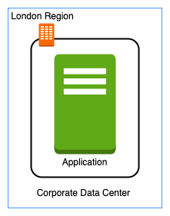
Regions and Zones
Imagine that your application is deployed in a data center in London What would be the challenges?
Challenge 1 : Slow access for users from other parts of the world (high latency)
Challenge 2 : What if the data center crashes?
Your application goes down (low availability)

Slide 7
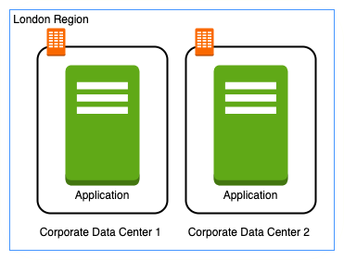
Multiple data centers
Let's add in one more data center in London What would be the challenges?
Challenge 1 : Slow access for users from other parts of the world
Challenge 2 (SOLVED) : What if one data center crashes?
Your application is still available from the other data center
Challenge 3 : What if entire region of London is unavailable?
Your application goes down

Slide 8
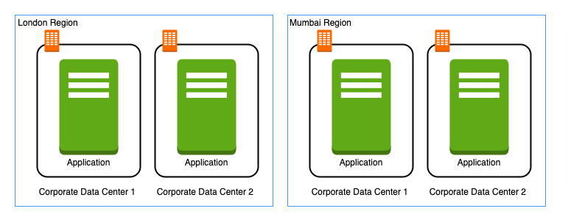
Multiple regions
Let's add a new region : Mumbai What would be the challenges?
Challenge 1 (PARTLY SOLVED) : Slow access for users from other parts of the world
You can solve this by adding deployments for your applications in other regions
Challenge 2 (SOLVED) : What if one data center crashes?
Your application is still live from the other data centers
Challenge 3 (SOLVED) : What if entire region of London is unavailable?
Your application is served from Mumbai

Slide 9
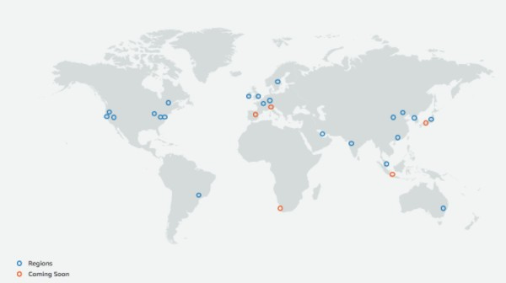
Regions
Imagine setting up your own data centers in different regions around the world
Would that be easy?
(Solution) AWS provides 20+ regions around the world (expanding every year)

Slide 10
Regions - Advantages
Low Latency
Global Footprint
Adhere to government regulations
High Availability

Slide 11
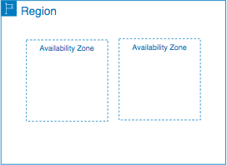
Availability Zones
Each AWS Region consists of multiple, isolated, and physically separate AZ's
Availability Zones in a Region are connected through
low-latency links
Each Availability Zone:
Can have One or more discrete data centers
has redundant power, networking, and connectivity
(Advantage) Increase availability and fault tolerance
of applications in the same region
(Advantage) Achieve high availability and greater fault-tolerance

Slide 12
Regions and Availability Zones examples
New Regions and AZs are constantly added
Region Code | Region | Availability Zones | Availability Zones List
us-east-1 | US East (N. Virginia) | 6 | us-east-1a us-east-1b us-east-1c us-east-1d us-east-1e us-east-1f
eu-west-2 | Europe (London) | 3 | eu-west-2a eu-west-2b eu-west-2c
ap-south-1 | Asia Pacific(Mumbai) | 3 | ap-south-1a ap-south-1b
ap-south-1c

Slide 13
Networking

Slide 14
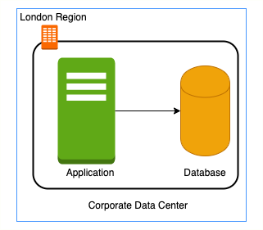
Need for Amazon VPC
In a corporate network or an on-premises data center:
Can anyone on the internet see the data exchange between the application and the database?
No
Can anyone from internet directly connect to your database?
Typically NO.
You need to connect to your corporate network and then access your applications or databases.
Corporate network provides a secure internal network protecting your resources, data and communication from external users
How do you do create your own private network in the cloud?
Enter Virtual Private Cloud (VPC)

Slide 15

Amazon VPC (Virtual Private Cloud)
Your own isolated network in AWS cloud
Network traffic within a VPC is isolated (not visible) from all other Amazon VPCs
You control all the traffic coming in and going outside a VPC
(Best Practice) Create all your AWS resources (compute, storage, databases etc) within a VPC
Secure resources from unauthorized access AND
Enable secure communication between your cloud resources

Slide 16

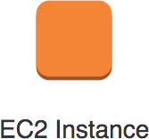
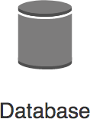
Need for VPC Subnets
Different resources are created on cloud - databases, compute (EC2) etc Each type of resource has its own access needs
Public Elastic Load Balancers are accessible from internet (public resources) Databases or EC2 instances should NOT be accessible from internet
ONLY applications within your network (VPC) should be able to access them(private
resources)
How do you separate public resources from private resources inside a VPC?

Slide 17
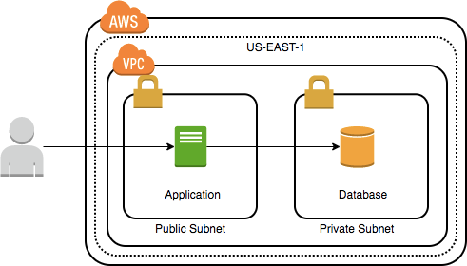
VPC Subnets
(Solution) Create different subnets for public and private resources
Resources in a public subnet CAN be accessed from
internet
Resources in a private subnet CANNOT be accessed from internet
BUT resources in public subnet can talk to resources in private subnet
Each VPC is created in a Region
Each Subnet is created in an Availability Zone Example : VPC - us-east-1 => Subnets - AZs us- east-1a or us-east-1b or ..

Slide 18
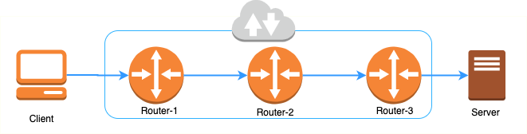
Routing on the internet
You have an IP address of a website you want to visit
There is no direct connection from your computer to the website Internet is actually a set of routers routing traffic
Each router has a set of rules that help it decide the path to the destination IP address

Slide 19
Routing inside AWS
Destination
Target
172.31.0.0/16
Local
0.0.0.0/0 igw-1234567
In AWS, route tables are used for routing
Route tables can be associated with VPCs and subnets Each route table consists of a set of rules called routes
Each route or routing rule has a destination and target
What Range of Addresses should be routed to which target resource?
Rule 1 - Route requests to VPC CIDR 172.31.0.0/16
(172.31.0.0 to
172.31.255.255) to local resources within the VPC
Rule 2 - Route all other IP addresses (0.0.0.0/0) to internet (internet gateway)

Slide 20

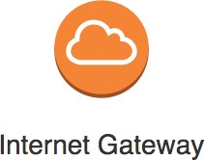
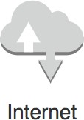
Public Subnet vs Private Subnet
Public Subnet
Communication allowed from subnet to internet
Communication allowed from internet to subnet
Private Subnet
Communication NOT allowed from internet to subnet

Slide 21
Public Subnet vs Private Subnet
Name | Destination | Target | Explanation
RULE 1 | 172.31.0.0/16 | Local | Local routing
RULE 2 | 0.0.0.0/0 | igw-1234567 | Internet routing
An Internet Gateway enables internet communication for subnets Any subnet which has a route to an internet gateway is called a public subnet
Any subnet which DOES NOT have route to an internet gateway is called a private subnet

Slide 22
Network Address Translation(NAT) Instance and Gateway
How do you allow instances in a private subnet to download sohware updates and security patches while denying inbound traffic from internet?
How do you allow instances in a private subnet to connect privately to other AWS Services outside the VPC?
Three Options:
NAT Gateway: Managed Service
NAT Instance: Install a EC2 instance with specific NAT AMI and configure as a gateway
Egress-Only Internet Gateways: For IPv6 subnets

Slide 23
NAT gateway vs NAT instance
Feature | NAT gateway | NAT instance
Managed by | AWS | You
Created in | Public Subnet | Public Subnet
Internet Gateway | Needed | Needed
High Availability | Yes (in an AZ) | You are responsible.
Multi AZ (higher availability)

Slide 24

Network Access Control List
Security groups control traffic to a specific resource in a subnet.
How about stopping traffic from even entering the subnet? NACL provides stateless firewall at subnet level.
Each subnet must be associated with a NACL.
Default NACL allows all inbound and outbound traffic.
Custom created NACL denies all inbound and outbound traffic by default.
Rules have a priority number.
Lower number => Higher priority.

Slide 25
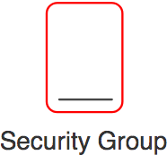
Security Group vs NACL
Feature | Security Group | NACL
Level | Assigned to a specific instance(s)/resource(s) | Configured for a subnet. Applies to traffic to all instances in a subnet.
Rules | Allow rules only | Both allow and deny rules
State | Stateful. Return traffic is automatically | Stateless. You should explicitly allow return traffic.
Evaluation | Traffic allowed if there is a matching | Rules are prioritized. Matching rule with highest priority
allowed.
rule
wins.

Slide 26
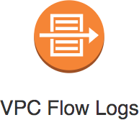
VPC Flow Logs
Monitor network traffic
Troubleshoot connectivity
issues (NACL and/or security
groups misconfiguration)
Capture traffic going in and out of your VPC (network interfaces)
Can be created for
a VPC
a subnet
Publish logs to Amazon CloudWatch Logs or Amazon S3 Flow log records contain ACCEPT or REJECT
Is traffic is permitted by security groups or network ACLs?

Slide 27
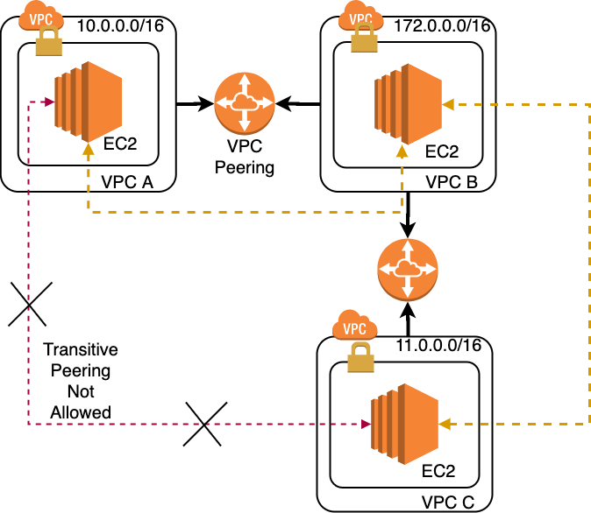
VPC Peering
Connect VPCs belonging to same or different AWS accounts irrespective of the region of the VPCs
Allows private communication between the connected VPCs
Peering uses a request/accept protocol
Owner of requesting VPC sends a request
Owner of the peer VPC has one week to accept

Slide 28
EC2 Fundamentals

Slide 29
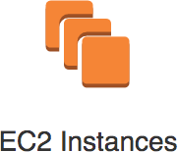
EC2 (Elastic Compute Cloud)
In corporate data centers, applications are deployed to physical servers Where do you deploy applications in the cloud?
Rent virtual servers
EC2 instances - Virtual servers in AWS
EC2 service - Provision EC2 instances or virtual servers

Slide 30
EC2 Features
Create and manage lifecycle of EC2 instances
Attach storage (& network storage) to your EC2 instances Manage network connectivity for an EC2 instance
Load balancing and auto scaling for multiple EC2 instances

Slide 31
EC2 Hands-on
Let's create a few EC2 instances and play with them
Let's use EC2 Instance Connect to SSH into EC2 instances

Slide 32
Useful Commands
sudo su
yum update -y
yum install httpd systemctl start httpd systemctl enable httpd
echo "Hello World 2" > /var/www/html/index.html

Slide 33

EC2 Concepts - AMI - Amazon Machine Image
What operating system and what software do you want on the instance? Three AMI sources:
Provided by AWS
AWS Market Place: Online store for customized AMIs. Per hour billing
Customized AMIs: Created by you.

Slide 34
EC2 Concepts - Instance Families
Optimized combination of compute(CPU, GPU), memory, disk (storage) and networking for specific workloads
270+ instances across 40+ types for different workloads
m (m4, m5, m6) - General Purpose
c (c4, c5, c5n) - Compute Optimized
r (r4, r5, r5a, r5n) - Memory (RAM) optimized i (i3) - Storage (I/O) optimized
g (g3, g4) - GPU Optimize - Graphics Processing

Slide 35
EC2 Important Concepts - Security Groups
Virtual firewall to control incoming and outgoing traffic to/from AWS resources (EC2 instances, databases etc)
Provides additional layer of security - Defense in Depth

Slide 36
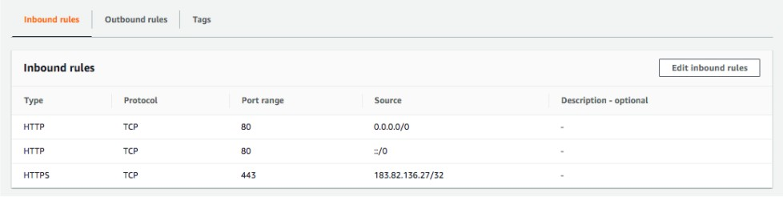
Security Groups Rules
Default deny - If there are no rules configured, no outbound/inbound traffic is allowed
Allows allow rules ONLY
Separate rules for inbound and outbound traffic

Slide 37
EC2 Security - Key Pairs
EC2 uses public key cryptography for protecting login credentials
Key pair - public key and a private key
Public key is stored in EC2 instance
Private key is stored by customer

Slide 38
EC2 IP Addresses
Public IP addresses are internet addressable.
Private IP addresses are internal to a corporate network
You CANNOT have two resources with same public IP address. HOWEVER, two different corporate networks CAN have resources with same private IP address
All EC2 instances are assigned private IP addresses
(Remember) When you stop an EC2 instance, public IP address is lost

Slide 39
Elastic IP Addresses
Scenario : How do you get a constant public IP address for a EC2 instance?
Quick and dirty way is to use an Elastic IP!
Elastic IP can be switched to another EC2 instance within the same region
Elastic IP remains attached even if you stop the instance. You have to manually detach it.
Remember : You are charged for an Elastic IP when you are NOT using it! Make sure that you explicitly release an Elastic IP when you are not using it

Slide 40
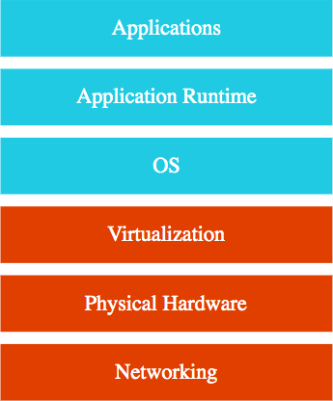
IAAS (Infrastructure as a Service)
Use only infrastructure from cloud provider
Computers (virtual or on dedicated hardware), data storage space and Networking features
Also called "Lih and Shih"
Example: Using EC2 to deploy your applications Example: Using EC2 to create your database Cloud Provider is responsible for:
Physical Infrastructure (Hardware, Networking)
Virtualization Layer (Hypervisor, Host OS)
Customer is responsible for:
Guest OS upgrades and patches
Application Code and Runtime
Availability, Fault Tolerance, Scalability etc.

Slide 41
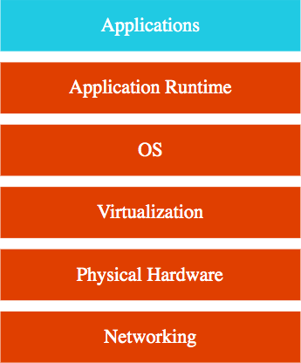
PAAS (Platform as a Service)
Use a platform provided by cloud
Cloud provider is responsible for:
OS (incl. upgrades and patches)
Application Runtime
Auto scaling, Availability & Load balancing etc..
Customer is responsible for:
Application code and/or
Configuration

Slide 42
EC2 Pricing Models

Slide 43
EC2 Pricing Models Overview
Pricing Description Model
On Demand
Request when you want it. Flexible and Most Expensive.
Web app with spiky traffic. Unpredictable batch which cannot be interrupted.
Spot
Cheapest (upto 90% off). Quote the maximum price. Terminated with 2 minute notice. Cost sensitive, Fault tolerant, Non immediate workloads.
Reserved
Reserve ahead of time. Upto 75% off. 1 or 3 years reservation.
Long Term Workloads. No Upfront or Partial Upfront or All Upfront Payments
Savings Plans
Commit spending $X per hour on (EC2 or AWS Fargate or Lambda). Upto 66% off. No restrictions. 1 or 3 years reservation.

Slide 44
EC2 Spot instances
(Old Model)
Bid a price. Highest bidder wins
(New Model) Quote your maximum price. Prices decided by long term trends. Up to 90% off (compared to On-Demand)
Can be terminated with a 2 minute notice
Ideal for Non time-critical workloads that can tolerate interruptions (fault- tolerant)
A batch program that does not have a strict deadline AND can be stopped at short notice and
re-started
Variations:
Spot Block: Request Spot instances for specific duration (1 or 2 .. or 6 hrs)
Spot Fleet: Request multiple spot instances across a range of instance types
More instance types => better chances of fulfilling your spot request

Slide 45
EC2 Reserved Instances
Standard: Commit to EC2 platform and an instance family for 1 year or 3 years. (Up to 75% off)
Convertible: Standard + flexibility to change EC2 platform and instance family. (Up to 54% off)
(NOT AVAILABLE ANYMORE)Scheduled: Reserve for specific time period in a day. (5% to 10% off)
You can sell reserved instances on the AWS Reserved instance marketplace if you do not want to use your reservation

Slide 46
EC2 Savings Plans
Compute Savings Plans
Commitment : I would spend X dollars per hour on AWS compute resources (Amazon EC2 instances, AWS Fargate and/or AWS Lambda) for a 1 or 3 year period
Up to 66% off (compared to on demand instances) Provides complete flexibility:
You can change instance family, size, OS, tenancy or AWS Region of your Amazon EC2 instances
You can switch between Amazon EC2, AWS Fargate and/or AWS Lambda
EC2 Instance Savings Plans
Commitment : I would spend X dollars per hour on Amazon EC2 instances of a specific instance family (General Purpose, for example) within a specific region (us-east-1, for example)
Up to 72% off (compared to on demand instances)
You can switch operating systems (Windows to Linux, for example)

Slide 47
Scaling EC2 instances

Slide 48
Scalability
Can we handle growth in users, traffic, or data without drop in performance?
Does ability to serve more growth increase proportionally with resources?
Vertical Scaling - Deploying to a bigger instance:
More RAM, CPU, I/O, or networking capabilities
Increasing EC2 instance size: Example: t2.micro to t2.small
Horizontal Scaling - Deploying multiple instances:
(Typically but not always) Horizontal Scaling is preferred to Vertical Scaling:
Horizontal scaling increases availability
Vertical scaling has limits and can be expensive
(BUT) Horizontal Scaling needs additional infrastructure: Load Balancers etc. Create Multiple EC2 instances:
In one AZ (OR) multiple AZs in one region (OR) multiple AZs in multiple regions
Auto scale: Auto Scaling Group. Distribute load : Elastic Load Balancer.

Slide 49
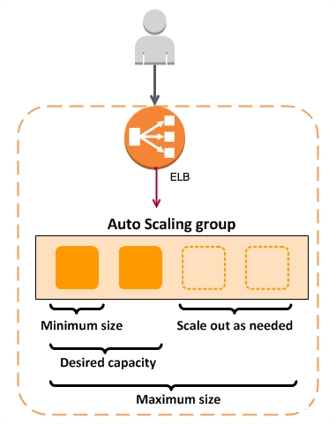
Auto Scaling Group
How to scale out and scale in automatically?
Configure a Auto Scaling Group
Auto Scaling Group responsibilities:
Maintain configured number of instances (using health checks)
If an instance goes down, ASG launches replacement instance
Auto scale to adjust to load
Scale-in and scale-out based on auto scaling policies
Can launch On-Demand Instances, Spot Instances, or both
Best Practice: Use Launch Template
Auto Scaling Group components:
Launch Configuration/Template - EC2 instance size and AMI
Auto Scaling Group
Min, max and desired size of ASG
EC2 health checks by default. Optionally enable ELB health checks.
Auto Scaling Policies - When and How to execute scaling?

Slide 50
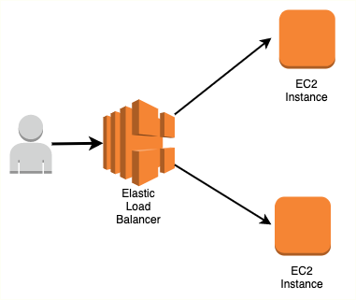
Elastic Load Balancer
ELB: Distribute traffic across Multiple Targets
EC2 instances can be in one or more AZs in a single region
Managed service:
AWS ensures that it is highly available
Auto scales to handle huge loads
Load Balancers can be public or private
Types:
Classic Load Balancer ( Layer 4 and Layer 7): (NOT RECOMMENDED)
Old generation supporting Layer 4(TCP/TLS) and Layer 7(HTTP/HTTPS) protocols
Application Load Balancer (Layer 7)
New Gen - HTTP/HTTPS and advanced routing approaches.
Network Load Balancer (Layer 4)
New Gen - TCP/TLS and UDP
Very high performance usecases
Gateway Load Balancers (Layer 3):
Manage third-party virtual appliances (typically )
Virtual appliances enable you to improve security, compliance, and policy controls

Slide 51
Application Load Balancer
Most popular and frequently used ELB in AWS
Supports WebSockets and HTTP/HTTPS (Layer 7) Supports all important load balancer features
Scales automatically based on demand (Auto Scaling) Can load balance between:
EC2 instances (AWS)
Containerized applications (Amazon ECS) Web applications (using IP addresses) Lambdas (serverless)

Slide 52
Best Practices for EC2 & ELB
Security
Use Security Groups to restrict traffic Place EC2 instances in private subnets
Use Dedicated Hosts when you have regulatory needs
Performance
Choose right instance family (Optimized combination of compute, memory, disk (storage) and networking)
Prefer creating an custom AMI to installing software using userdata Choose the right ELB for your use case
Prefer Network Load Balancer for high performance load balancing

Slide 53
Best Practices for EC2 & ELB - 2
Cost Efficiency
Have optimal number and type of EC2 instances running Use the right mix of:
Savings Plans
Reserved Instances On demand Instances Spot Instances
Resiliency
Configure the right health checks
Use CloudWatch for monitoring
(Disaster recovery) Upto date AMI copied to multiple regions

Slide 54
Elastic Load Balancer
Distribute traffic across EC2 instances in one or more AZs in a single region
Managed service - AWS ensures that it is highly available
Auto scales to handle huge loads
Load Balancers can be public or private
Health checks - route traffic to healthy instances

Slide 55
Availability
Are the applications available when the users need them?
Percentage of time an application provides the operations expected of it
Example: 99.99% availability. Also called four 9's availability
Availability Table
Availability | Downtime (in a month) | Comment
99.95% | 22 minutes
99.99% (four 9's) | 4 and 1/2 minutes | Most online apps aim for 99.99% (four 9's)
99.999% (five 9's) | 26 seconds | Achieving 5 9's availability is tough

Slide 56
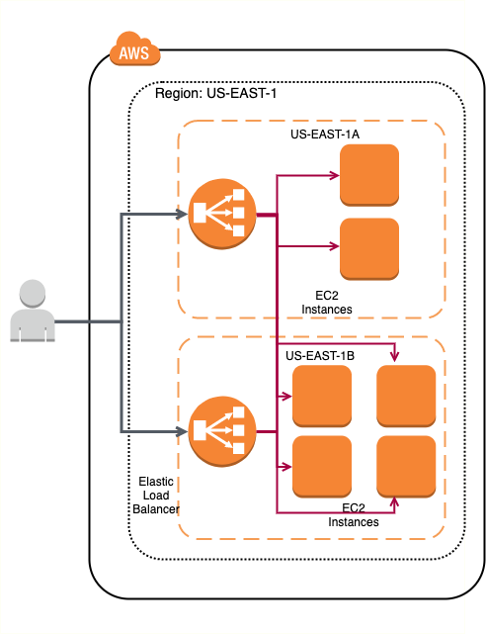
Availability Basics - EC2 and ELB
Deploy to multiple AZs Deploy to multiple regions

Slide 57
Scalability
A system is handling 1000 transactions per second. Load is expected to increase 10 times in the next month
Can we handle a growth in users, traffic, or data size without any drop in performance?
Does ability to serve more growth increase proportionally with resources?
Ability to adapt to changes in demand (users, data) What are the options that can be considered?
Deploy to a bigger instance with bigger CPU and more memory
Increase the number of application instances and setup a load balancer And a lot more.

Slide 58
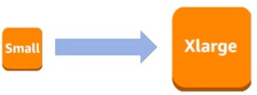
Vertical Scaling
Deploying application/database to bigger instance:
A larger hard drive
A faster CPU
More RAM, CPU, I/O, or networking capabilities
There are limits to vertical scaling

Slide 59
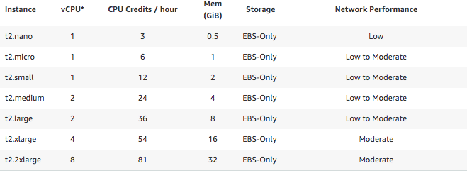
Vertical Scaling for EC2
Increasing EC2 instance size:
t2.micro to t2.small or
t2.small to t2.2xlarge or
...

Slide 60
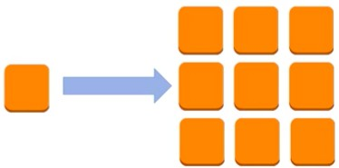
Horizontal Scaling
Deploying multiple instances of application/database
(Typically but not always) Horizontal Scaling is preferred to Vertical Scaling:
Vertical scaling has limits
Vertical scaling can be expensive
Horizontal scaling increases availability
(BUT) Horizontal Scaling needs additional infrastructure:
Load Balancers etc.

Slide 61
Horizontal Scaling for EC2
Distribute EC2 instances
in a single AZ
in multiple AZs in single region
in multiple AZs in multiple regions
Auto scale: Auto Scaling Group
Distribute load : Elastic Load Balancer

Slide 62
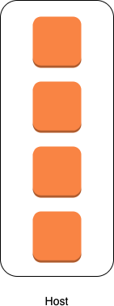
EC2 Tenancy - Shared vs Dedicated
Shared Tenancy (Default)
Single host machine can have instances from multiple customers
EC2 Dedicated Instances
Virtualized instances on hardware dedicated to one customer
You do NOT have visibility into the hardware of underlying host
EC2 Dedicated Hosts
Physical servers dedicated to one customer
You have visibility into the hardware of underlying host (sockets and physical cores)
(Use cases) Regulatory needs or server-bound software licenses like Windows Server, SQL Server

Slide 63
Storage

Slide 64
Amazon S3 (Simple Storage Service)
Most popular, very flexible & inexpensive storage service Store large objects using a key-value approach
Also called Object Storage
Provides REST API to access and modify objects
(S3 storage class) 99.99% availability & (11 9's - 99.999999999) durability
Objects are replicated in a single region (across multiple AZs)
Provides unlimited storage:
Store all file types - text, binary, backup & archives:
Media files and archives
Application packages and logs
Backups of your databases or storage devices
Staging data during on-premise to cloud database migration

Slide 65
Amazon S3 - Objects and Buckets
Amazon S3 is a global service. NOT associated with a region.
HOWEVER a bucket is created in a specific AWS region
Objects are stored in buckets
Bucket names are globally unique
Bucket names are used as part of object URLs => Can contain ONLY lower case letters, numbers, hyphens and periods.
Unlimited objects in a bucket
Each object is identified by a key value pair
Key is unique in a bucket
Max object size is 5 TB

Slide 66
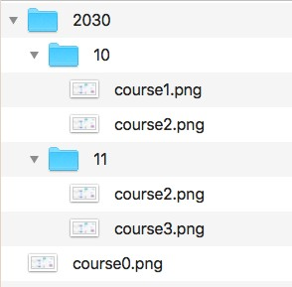
Amazon S3 Key Value Example
Key Value
2030/course0.png image-binary-content 2030/10/course1.png image-binary-content 2030/10/course2.png image-binary-content 2030/11/course2.png image-binary-content 2030/11/course3.png image-binary-content

Slide 67
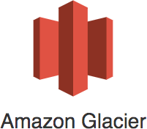
Amazon S3 Storage Classes - Introduction
Different kinds of data can be stored in Amazon S3
Media files and archives
Application packages and logs
Backups of your databases or storage devices Long term archives
Huge variations in access patterns
Trade-off between access time and cost
S3 storage classes help to optimize your costs while meeting access time needs

Slide 68
Amazon S3 Storage Classes
Storage Class | Scenario | AZs
Standard | Frequently accessed data | >=3
Standard-IA | Long-lived, infrequently accessed data (backups for disaster recovery) | >=3
One Zone-IA | Long-lived, infrequently accessed, non-critical data (Easily re-creatable | 1
Intelligent-Tiering | Long-lived data with changing or unknown access patterns | >=3
Glacier | Archive data with retrieval times ranging from minutes to hours | >=3
Glacier Deep Archive | Archive data that rarely, if ever, needs to be accessed with retrieval | >=3
Reduced Redundancy (Not | Frequently accessed, non-critical data | >=3
data - thumbnails for images)
times in hours
recommended)

Slide 69
Amazon S3 Storage Classes - Comparison
Feature | Standard | Intelligent Tiering | Standard IA | One Zone IA | Glacier Glacier Deep Archive
Availability (Designed) | 99.99% | 99.9% | 99.9% | 99.5% | 99.99% 99.99%
Availability (SLA) | 99.9% | 99% | 99% | 99% | 99.9% 99.9%
Replication AZs | >=3 | >=3 | >=3 | 1 | >=3 >=3
First byte: ms (milliseconds) | ms | ms | ms | ms | minutes or few hours hours
Per GB Cost (varies) | $0.025 | varies | $0.018 | $0.0144 | $0.005 $0.002
Encryption | Optional | Optional | Optional | Optional | Mandatory Mandatory

Slide 70
Amazon S3 Cost
Important pricing elements:
Cost of Storage (per GB)
(If Applicable) Retrieval Charge (per GB)
Monthly tiering fee (Only for Intelligent Tiering) Data transfer fee
FREE of cost:
Data transfer into Amazon S3
Data transfer from Amazon S3 to Amazon CloudFront
Data transfer from Amazon S3 to services in the same region

Slide 71
Amazon S3 Glacier
In addition to existing as a S3 Storage Class, S3 Glacier is a separate AWS Service on it own!
Extremely low cost storage for archives and long-term backups:
Old media content
Archives to meet regulatory requirements (old patient records etc) As a replacement for magnetic tapes
High durability (11 9s - 99.999999999%) High scalability (unlimited storage)
High security (encrypted at rest and in transfer)

Slide 72
Amazon S3 vs S3 Glacier
Feature | Amazon S3 | S3 Glacier
Terminology | Objects (files) are stored in Buckets | Archives (files) are stored in Vaults (containers)
Keys | Objects keys are user defined | Archive keys are system generated identifiers
Mutability | (Default) Allows uploading new content to object | After an archive is created, it cannot be updated (Perfect for regulatory compliance)
Max size | Each object can be upto 5TB | Each archive can be upto 40TB
Encryption | Optional | Mandatory using AWS managed keys and AES-
(containers)
256.
You can use client side encryption on top of this.

Slide 73
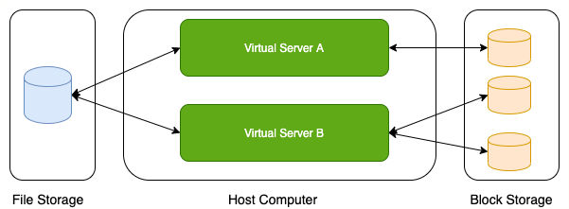
Storage Types - Block Storage and File Storage
What is the type of storage of your hard disk?
Block Storage
You've created a file share to share a set of files with your colleagues in a enterprise. What type of storage are you using?
File Storage

Slide 74
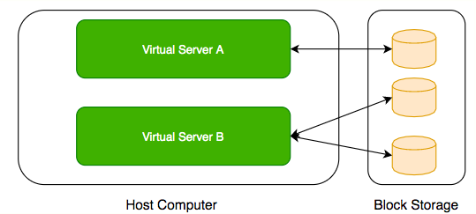
Block Storage
Use case: Hard-disks computers
attached to your
Typically, ONE Block Storage device can be connected to ONE virtual server
HOWEVER, you can connect multiple different block storage devices to one virtual server

Slide 75
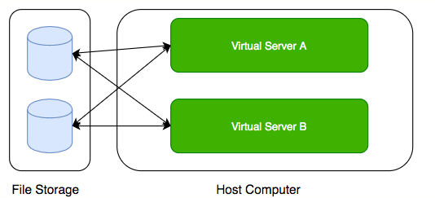
File Storage
Media workflows need huge shared storage for supporting processes like video editing
Enterprise users need a quick way to share files in a secure and organized way
These file shares are shared by several virtual servers

Slide 76
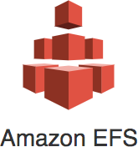
AWS - Block Storage and File Storage
Block Storage:
Amazon Elastic Block Store (EBS)
Instance store
File Storage:
Amazon EFS (for Linux instances)
Amazon FSx Windows File Servers
Amazon FSx for Lustre (high performance use cases)

Slide 77
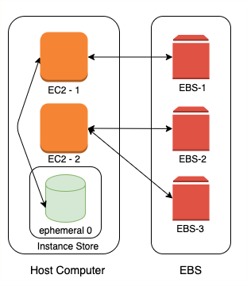
EC2 - Block Storage
Two popular types of block storage can be attached to EC2 instances:
Elastic Block Store (EBS)
Instance Store
Instance Stores are physically attached to the EC2 instance
Temporary data
Lifecycle tied to EC2 instance
Elastic Block Store (EBS) is network storage
More durable
Lifecycle NOT tied to EC2 instance

Slide 78
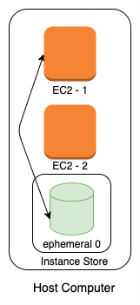
Instance Store
Physically attached to your EC2 instance
Ephemeral storage
Temporary data.
Data is lost when hardware fails or an instance is terminated. Use case: cache or scratch files
Lifecycle is tied to EC2 instance
Only some of the EC2 instance types support Instance Store

Slide 79
Instance Store - Advantages and Disadvantages
Advantages
Very Fast I/O (2-100X of EBS)
(Cost Effective) No extra cost. Cost is included in the cost of EC2 instance Ideal for storing temporary information - cache, scratch files etc
Disadvantages
Slow boot up (up to 5 minutes)
Ephemeral storage (data is lost when hardware fails or instance is terminated)
CANNOT take a snapshot or restore from snapshot Fixed size based on instance type
You cannot detach and attach it to another EC2 instance

Slide 80
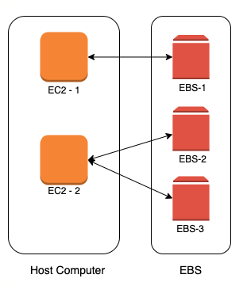
Amazon Elastic Block Store (EBS)
Network block storage attached to your EC2 instance
Provisioned capacity
Very flexible.
Increase size when you need it - when attached to EC2 instance
Independent lifecycle from EC2 instance
Attach/Detach from one EC2 instance to another
99.999% Availability & replicated within the same AZ
Use case : Run your custom database

Slide 81
Amazon EBS vs Instance Store
Feature | Elastic Block Store (EBS) | Instance Store
Attachment to EC2 instance | As a network drive | Physically attached
Lifecycle | Separate from EC2 instance | Tied with EC2 instance
Cost | Depends on provisioned size | Zero (Included in EC2 instance cost)
Flexibility | Increase size | Fixed size
I/O Speed | Lower (network latency) | 2-100X of EBS
Snapshots | Supported | Not Supported
Use case | Permanent storage | Ephemeral storage
Boot up time | Low | High

Slide 82
Hard Disk Drive vs Solid State Drive
Amazon EBS oﬀers HDD and SSD options!
How do you choose between them?
Feature | HDD(Hard Disk Drive) | SSD(Solid State Drive)
Performance - IOPS | Low | High
Throughput | High | High
Great at | Large sequential I/O operations | Small, Random I/O operations & Sequential I/O
Recommended for | Large streaming or big data workloads | Transactional workloads
Cost | Low | Expensive
Boot Volumes | Not Recommended | Recommended

Slide 83
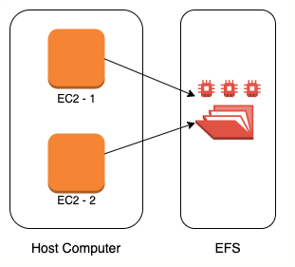
Amazon EFS
Petabyte scale, Auto scaling, Pay for use shared file storage Compatible with Amazon EC2 Linux-based instances
(Usecases) Home directories, file share, content management (Alternative) Amazon FSx for Lustre
File system optimized for performance
High performance computing (HPC) and media processing use cases Automatic encryption at-rest and in-transit
(Alternative) Amazon FSx Windows File Servers
Fully managed Windows file servers
Accessible from Windows, Linux and MacOS instances
Integrates with Microsoft Active Directory (AD) to support Windows-based environments and enterprises.
Automatic encryption at-rest and in-transit

Slide 84
Review of storage options
Type | Examples | Latency | Throughput | Shareable
Block | EBS, Instance Store | Lowest | Single | Attached to one instance at a time. Take snapshots to share.
File | EFS, FSx Windows, FSx | Low | Multiple | Yes
Object | S3 | Low | Web Scale | Yes
Archival | Glacier | Minutes to | High | No
for Lustre
hours

Slide 85
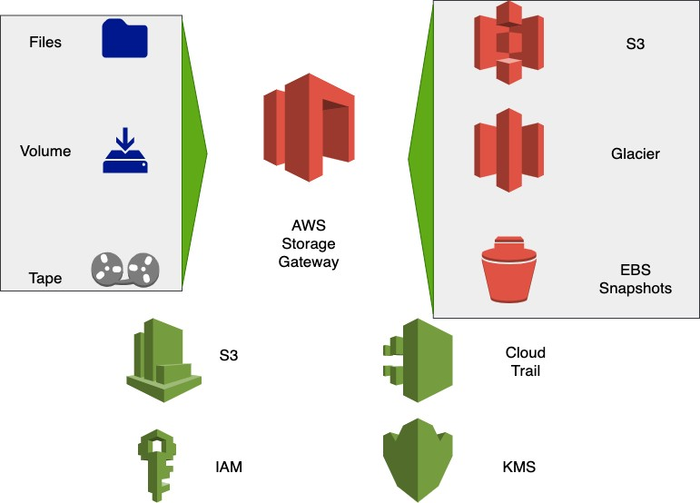
AWS Storage Gateway
Hybrid storage (cloud + on premise) Unlimited cloud storage for on-
premise software applications and users with good performance
(Remember) Storage Gateway and S3 Glacier encrypt data by default
Three Options
AWS Storage File Gateway
AWS Storage Tape Gateway AWS Storage Volume Gateway

Slide 86
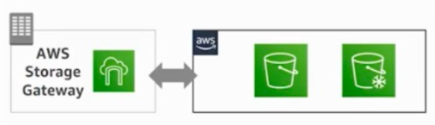
AWS Storage File Gateway
Problem Statement: Large on- premise file share with terabytes of data
Users put files into file share and
applications use the files
Managing it is becoming expensive
Move the file share to cloud without performance impact
AWS Storage File Gateway provides cloud storage for your file shares
Files stored in Amazon S3 & Glacier

Slide 87
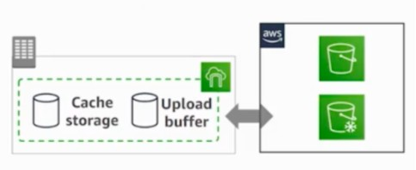
AWS Storage Tape Gateway
Tape backups used in enterprises (archives)
Stored off-site - expensive, physical wear and tear
AWS Storage Tape Gateway - Avoid physical tape backups
No change needed for infrastructure
tape
tapes
backup
(actually,
Backup data to virtual Amazon S3 & Glacier)

Slide 88
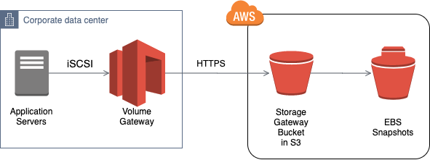
AWS Storage Volume Gateway
Volume Gateway : Move block storage to cloud Automate backup and disaster recovery
Use cases: Backup and disaster recovery, Migration of application data
(Option 1) Cached (Gateway Cached Volumes):
Primary Data Store - AWS - Amazon S3
On-premise cache stores frequently accessed data
(Option 2) Stored (Gateway Stored Volumes):
Primary Data Store - On-Premises
Asynchronous copy to AWS Stored as EBS snapshots

Slide 89
AWS Storage Gateway - Summary
Key to look for : Hybrid storage (cloud
+ on premise)
File share moved to cloud => AWS Storage File Gateway
Tape Backups on cloud => AWS Storage Tape Gateway
Volume Backups on cloud (Block Storage) => AWS Storage Volume Gateway
High performance => Stored
Otherwise => Cached

Slide 90
Identity and Access Management

Slide 91
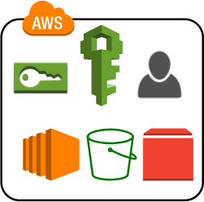
AWS Identity and Access Management (IAM)
Authentication (the right user?) and Authorization (the right access?) Identities can be
AWS users or
Federated users (externally authenticated users)
Provides very granular control
Limit a single user:
to perform single action
on a specific AWS resource from a specific IP address during a specific time window

Slide 92
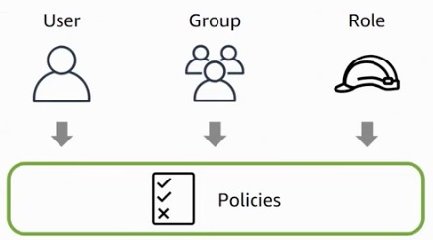
Important IAM Concepts
IAM users: Users created in an AWS account
Has credentials attached (name/password or access keys)
IAM groups: Collection of IAM users
Roles: Temporary identities
Does NOT have credentials attached
(Advantage) Expire after a set period of time
Policies: Define permissions
AWS managed policies - Standalone policy predefined by AWS
Customer managed policies - Standalone policy created by you
Inline policies - Directly embedded into a user, group or role

Slide 93
AWS IAM Policies - Authorization
{
"Version": "2012-10-17",
"Statement": [
{
"Effect": "Allow",
"Action": "*", //["s3:Get*","s3:List*"],
"Resource": "*" //"arn:aws:s3:::mybucket/somefolder/*"
}
]
}
Policy is a JSON document with one or more permissions
Effect - Allow or Deny
Resource - Which resource are you providing access to?
Action - What actions are allowed on the resource?
Condition - Are there any restrictions on IP address ranges or time intervals? Example above: AWS Managed Policy : AdministratorAccess
Give Read Only Access to S3 buckets - "Action": ["s3:Get*","s3:List*"]

Slide 94
IAM Scenarios
Scenario | User/Role | Recommendation
You're the only one in your account | IAM user | Do not use ROOT user
Your team needs access to your AWS account and there is no other identity mechanism | IAM users | Use IAM Groups to manage policies
EC2 instance talks with Amazon S3 or a database | IAM role
Cross Account Access | IAM role

Slide 95
IAM Role Use case 1 : EC2 talking with S3
1: Create IAM role with access to S3 bucket
2: Assign IAM role to EC2 instance
No need to store credentials in config files No need for rotation of keys
What happens in the background?
Instance Profile: A Container (A Box) for an IAM role
Used to pass role information to an EC2 instance
Creation:
An instance profile is automatically created when you create a role for EC2 instance
From CLI or API
Explicitly manage Instance Profiles - CreateInstanceProfile etc
(REMEMBER) Instance profile is a simple container for IAM Role
AWS Management Console:

Slide 96

IAM Role Use case 2: Cross Account Access
PROD Account (111111111111)
1: Create IAM role (ProdS3AccessRole) with right permissions
2: Establish trust relationship with DEV AWS account (222222222222)
DEV Account (222222222222)
Grant users (Ops Group) permissions to assume ProdS3AccessRole in PROD Account 1: Create a customer managed policy ProdS3AccessPolicy allowing access to call STS AssumeRole API for ProdS3AccessRole(arn:aws:iam::111111111111:role/ProdS3AccessRole)
2: Assign the policy to users (Ops Group)
(Optional) 3: Enable MFA for assuming the role
What happens when DEV AWS account Ops user requests access to Prod Account role?
1: Operations user requests access to the role
2: AWS STS AssumeRole API is called to check for access to ProdS3AccessRole role 3: Operations user assumes the role

Slide 97
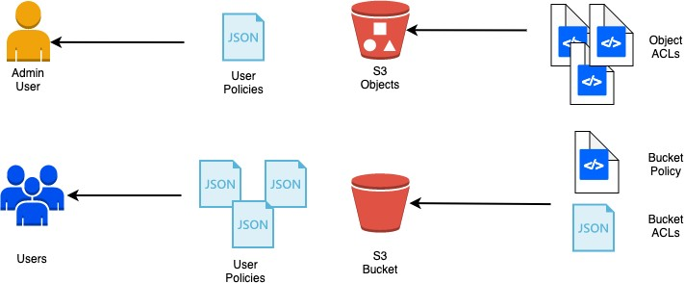
Identity-based and Resource-based policies
By default only account owner has access to a S3 bucket
Access policies enable other users to access S3 buckets and objects:
Identity-based policies : Attached to an IAM user, group, or role
Resource-based policies and ACLs : Attached to a resource - S3 buckets, Amazon SQS queues, and AWS KMS keys

Slide 98
Identity-based and Resource-based policies
Policy Type | Identity-based | Resource-based
Attached with | IAM user, group, or role | A resource
Type | Managed and Inline | Inline only
Focus | What resource? What actions? | Who? What actions?
Example | Can list S3 buckets with name XYZ | Account A can read and modify. Public can read.
Cross-account access | User should switch role | Simpler. User accesses resource directly from his AWS account
Supported by | All services | Subset of services - S3, SQS, SNS, KMS etc
Policy | When (dates), Where(CIDR | When(dates), Where(CIDR blocks), Is SSL
Conditions
blocks),Enforcing MFA
Mandatory?

Slide 99

IAM Best Practices - Recommended by AWS
Users – Create individual users
Groups – Manage permissions with groups Permissions – Grant least privilege Auditing – Turn on AWS CloudTrail
Password – Configure a strong password policy
MFA – Enable MFA for privileged users
(Hardware device - Gemalto, Virtual device - An app on a smart phone)
Roles – Use IAM roles for Amazon EC2 instances
Sharing – Use IAM roles to share access
Rotate – Rotate security credentials regularly
Root – Reduce or remove use of root

Slide 100
Databases

Slide 101
Databases Primer
Databases provide organized and persistent storage for your data
To choose between different database types, we would need to understand:
Availability
Durability Consistency
Transactions etc
Let's get started on a simple journey to understand these

Slide 102
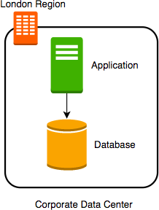
Database - Getting Started
Imagine a database deployed in a data center in London
Let's consider some challenges:
Challenge 1: Your database will go down if the data center crashes or the server storage fails
Challenge 2: You will lose data if the database crashes

Slide 103
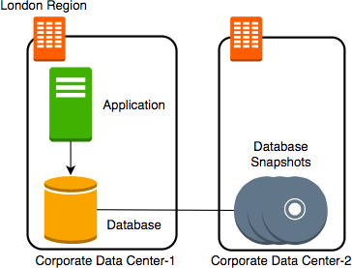
Database - Snapshots
Let's automate taking copy of the database (take a snapshot) every hour to another data center in London
Let's consider some challenges:
Challenge 1: Your database will go down if the data center crashes
Challenge 2 (PARTIALLY SOLVED): You will lose data if the database crashes
You can setup database from latest snapshot. But depending on when failure occurs you can lose up to an hour of data
Challenge 3(NEW): Database will be slow when you take snapshots

Slide 104
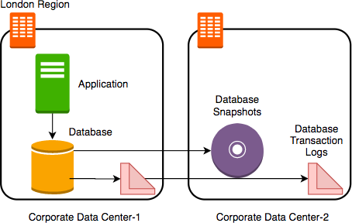
Database - Transaction Logs
Let's add transaction logs to database and create a process to copy it over to the second data center
Let's consider some challenges:
Challenge 1: Your database will go down if the data center crashes
Challenge 2 (SOLVED): You will lose data if the database crashes
You can setup database from latest snapshot and apply transaction logs
Challenge 3: Database will be slow when you take snapshots

Slide 105
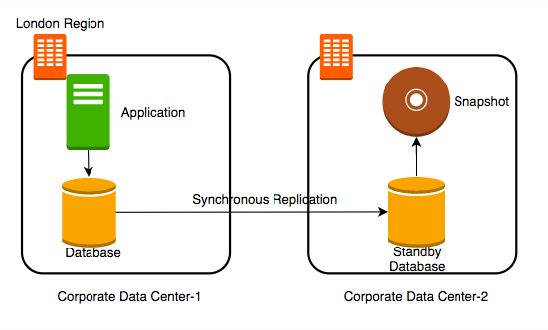
Database - Add a Standby
Let's add a standby database in the second data center with replication Let's consider some challenges:
Challenge 1 (SOLVED): Your database will go
down if the data center crashes
You can switch to the standby database
Challenge 2 (SOLVED): You will lose data if the database crashes
Challenge 3 (SOLVED): Database will be slow when you take snapshots
Take snapshots from standby.
Applications connecting to master will get good performance always

Slide 106
Availability and Durability
Availability
Will I be able to access my data now and when I need it?
Percentage of time an application provides the operations expected of it
Durability
Will my data be available after 10 or 100 or 1000 years?
Examples of measuring availability and durability:
4 9's - 99.99
11 9's - 99.999999999
Typically, an availability of four 9's is considered very good Typically, a durability of eleven 9's is considered very good

Slide 107
Availability
Availability | Downtime (in a month) | Comment
99.95% | 22 minutes
99.99% (4 9's) | 4 and 1/2 minutes | Typically online apps aim for 99.99% (4 9's) availability
99.999% (5 9's) | 26 seconds | Achieving 5 9's availability is tough

Slide 108
Durability
What does a durability of 11 9's
mean?
If you store one million files for ten million years, you would expect to lose one file
Why should durability be high?
Because we hate losing data
Once we lose data, it is gone

Slide 109
Increasing Availability and Durability of Databases
Increasing Availability:
Have multiple standbys available
in multiple AZs
in multiple Regions
Increasing Durability:
Multiple copies of data (standbys, snapshots, transaction logs and replicas)
in multiple AZs
in multiple Regions
Replicating data comes with its own challenges!
We will talk about them a little later

Slide 110
Database Terminology : RTO and RPO
Imagine a financial transaction being lost
Imagine a trade being lost
Imagine a stock exchange going down for an hour
Typically businesses are fine with some downtime but they hate losing data
Availability and Durability are technical measures
How do we measure how quickly we can recover from
RPO (Recovery Point Objective): Maximum acceptable period of data loss
RTO (Recovery Time Objective): Maximum acceptable downtime
Achieving minimum RTO and RPO is expensive Trade-off based on the criticality of the data
failure?

Slide 111
Achieving RTO and RPO - Failover Examples
Scenario Solution
Very small data loss (RPO - 1 minute) Very small downtime (RTO - 5 minutes)
Hot standby - Automatically synchronize data Have a standby ready to pick up load
Use automatic failover from master to standby
Very small data loss (RPO - 1 minute)
BUT I can tolerate some downtimes (RTO - 15 minutes)
Warm standby - Automatically synchronize data Have a standby with minimum infrastructure Scale it up when a failure happens
Data is critical (RPO - 1 minute) but I can tolerate downtime of a few hours (RTO - few hours)
Create regular data snapshots and transaction logs
Create database from snapshots and
transactions logs when a failure happens
Data can be lost without a problem (for example: cached data)
Failover to a completely new server

Slide 112

(New Scenario) Reporting and Analytics Applications
New reporting and analytics applications are being launched using the same database
These applications will ONLY read data
Within a few days you see that the database performance is impacted
How can we fix the problem?
Vertically scale the database - increase CPU and memory
Create a database cluster - typically database clusters are expensive to setup
Create read replicas - Run read only applications against read replicas

Slide 113

Database - Read Replicas
Add read replica
Connect reporting and analytics applications to read replica
Reduces load on the master databases Upgrade read replica to master database (supported by some databases)
Create read replicas in multiple regions Take snapshots from read replicas

Slide 114
Consistency
How do you ensure that data in multiple database instances (standbys and replicas) is updated simultaneously?
Strong consistency - Synchronous replication to all replicas
Will be slow if you have multiple replicas or standbys
Eventual consistency - Asynchronous replication. A little lag - few seconds - before the change is available in all replicas
In the intermediate period, different replicas might return different values
Used when scalability is more important than data integrity
Examples : Social Media Posts - Facebook status messages, Twitter tweets, Linked in posts etc
Read-aher-Write consistency - Inserts are immediately available. Updates and deletes are eventually consistent
Amazon S3 provides read-after-write consistency

Slide 115
Database Categories
There are several categories of databases:
Relational (OLTP and OLAP), Document, Key Value, Graph etc
Choosing type of database for your use case is not easy. A few factors:
Do you want a fixed schema?
Do you want flexibility in defining and changing your schema? (schemaless)
What level of transaction properties do you need? (example: consistency)
What kind of latency do you want? (seconds, milliseconds or microseconds)
How many transactions do you expect? (hundreds or thousands or millions of transactions per second)
How much data will be stored? (MBs or GBs or TBs or PBs) and a lot more...

Slide 116

Relational Databases
Only option until a decade back!
Most popular (or unpopular) type of databases
Predefined schema - tables & relationships
Supports Complex SQL Queries
Very strong transactional capabilities Used for
OLTP (Online Transaction Processing) use
cases and
OLAP (Online Analytics Processing) use cases

Slide 117
Relational Database - OLTP (Online Transaction Processing)
Applications where large number of users make large number of small transactions
small data reads, updates and deletes
Use cases: Most traditional applications, ERP, CRM, e-commerce, banking applications
Popular databases: MySQL, Oracle, SQL Server etc

Slide 118

Amazon RDS (Relational Database Service)
Do you want to manage the setup, backup, scaling, replication and patching of your relational databases?
Or do you want to use a managed service?
Amazon RDS is a managed relational database service for OLTP use cases
Supports:
Amazon Aurora
PostgreSQL
MySQL (InnoDB storage engine full supported) MariaDB (Enhanced MySQL)
Oracle Database Microsoft SQL Server

Slide 119
Amazon RDS - Features
Multi-AZ deployment (standby in another AZ) Read replicas:
Same AZ
Multi AZ (Availability+)
Cross Region(Availability++)
Storage auto scaling (up to a configured limit) Automated backups (restore to point in time) Manual snapshots

Slide 120
Amazon RDS - You vs AWS
AWS is responsible for
Availability (according to your configuration)
Durability
Scaling (according to your configuration) Maintenance (patches)
Backups
You are responsible for
Managing database users
App optimization (tables, indexes etc)
You CANNOT
SSH into database EC2 instances or setup custom software (NOT ALLOWED)
Install OS or DB patches. RDS takes care of them (NOT ALLOWED)

Slide 121
Amazon Aurora
MySQL and PostgreSQL-compatible
2 copies of data each in a minimum of 3 AZ Provides "Global Database" option
Up to five read-only, secondary AWS Regions
Low latency for global reads
Safe from region-wide outages
Minimal lag time, typically less than 1 second

Slide 122
Amazon RDS - When to use?
Use Amazon RDS for transactional applications needing
Pre-defined schema
Strong transactional capabilities Complex queries
Amazon RDS is NOT recommended when
You need highly scalable massive read/write operations - for example millions of writes/second
Go for DynamoDB
When you want to upload files using simple GET/PUT REST API
Go for Amazon S3
When you need heavy customizations for your database or need access to underlying EC2 instances
Go for a custom database installation

Slide 123
RDS - Scenarios
Scenario
You want full control of OS or need elevated permissions
You want to migrate data from an on-premise database to cloud database of the same type
I will need RDS for at least one year. How can I reduce costs?
Solution
Consider going for a custom installation (EC2 + EBS)
Consider using AWS Database Migration Service
Use Amazon RDS reserved instances.

Slide 124

Relational Database - OLAP (Online Analytics Processing)
Applications allowing users to analyze petabytes of data
Examples : Reporting applications,
Data ware
houses, applications,
Business Analytics
intelligence
systems
Sample application : Decide insurance premiums analyzing data from last hundred years
Data is consolidated from multiple (transactional) databases

Slide 125

Relational Databases - OLAP vs OLTP
OLAP and OLTP use similar data structures
BUT very different approach in how data is stored
OLTP databases use row storage
Each table row is stored together
Efficient for processing small transactions
OLAP databases use columnar storage
Each table column is stored together
High compression - store petabytes of data efficiently
Distribute data - one table in multiple cluster nodes
Execute single query across multiple nodes - Complex queries can be executed efficiently

Slide 126

Amazon Redshih
Redshift is a relational database ( tables and relationships) What is the need for another relational database?
RDS is optimized for online transaction processing
RDS is optimized to provide a balance between both reads and write operations
(However) OLAP workloads have exponentially larger reads on the databases compared to writes:
Can we use a different approach to design the database?
How about creating a cluster and splitting the execution of the same query across several nodes?
Redshift is a petabyte-scale distributed data ware house
based on PostgreSQL

Slide 127
Amazon Redshih
Three important characteristics of Redshift:
Massively parallel processing (MPP) - storage and processing can be split across multiple nodes
Columnar data storage High data compression
As a result
A single row of data might be stored across multiple nodes
A query to Redshift leader node is distributed to multiple compute nodes for execution
Start with a single node configuration and scale to multi node configuration
You can dynamically add and remove nodes

Slide 128
Amazon Redshih
Used for traditional ETL(Extract, Transform, Load), OLAP and Business Intelligence (BI) use cases
Optimized for high-performance analysis and reporting of very large
datasets
Supports standard SQL
Integration with data loading, reporting, mining and analytics tools

Slide 129
Amazon EMR - Elastic MapReduce
Managed Hadoop service with high availability and durability EMR gives access to underlying OS => You can SSH into it Important tools in Hadoop eco system are natively supported:
Examples: Pig, Hive, Spark or Presto
Install others using bootstrap actions Use cases
Log processing for insights
Click stream analysis for advertisers
Genomic and life science dataset processing

Slide 130

Amazon Redshih Spectrum
Run SQL queries against datasets in Amazon S3
Does need for any intermediate data stores
Auto scales based on your queries
Scale storage and compute independently
Eliminate expensive data transfers from S3 to data warehousing solutions (Cost effective)
Query against Amazon EMR (as well)

Slide 131
Amazon Redshih and EMR Alternatives
Alternative Scenario
Amazon EMR
For big data frameworks like Apache Spark, Hadoop, Presto, or Hbase to do large scale data processing that needs high customization
For example: machine learning, graph analytics etc
Amazon Redshih
Run complex queries against data warehouse - housing structured and unstructured data pulled in from a variety of sources
Amazon Redshih Spectrum
Run queries directly against S3 without worrying about loading entire data from S3 into a data warehouse
Amazon Athena
Quick ad-hoc queries without worrying about provisioning a compute cluster (serverless) Amazon Redshift Spectrum is recommended if you are executing queries frequently against structured data

Slide 132


Document Database
Structure data the way your application needs it
Create one table instead of dozens!
Quickly evolving semi structured data (schema-less) Easily distributable
Advantages : (Horizontally) Scalable to terabytes of data with millisecond responses upto millions of transactions per second
Use cases : Content management, catalogs, user profiles

Slide 133

Amazon DynamoDB
Fast, scalable, distributed for any scale
Flexible NoSQL Key-value & document database (schemaless) Single-digit millisecond responses for million of TPS
Do not worry about scaling, availability or durability
Automatically partitions data as it grows
Maintains 3 replicas within the same region
No need to provision a database
Create a table and configure read and write capacity (RCU and WCU)
Automatically scales to meet your RCU and WCU
Provides an expensive serverless mode
Use cases: User profiles, shopping carts, high volume read write applications

Slide 134
DynamoDB Tables
Hierarchy : Table > item(s) > attribute (key value pair) Mandatory primary key
Other than the primary key, tables are schemaless
No need to define the other attributes or types
Each item in a table can have distinct attributes
Max 400 KB per item in table
Use S3 for large objects and DynamoDB for smaller objects

Slide 135
DynamoDB vs RDS
Feature | DynamoDB | RDS
Scenario | Millisecond latency with millions of TPS | Stronger consistency (schema) and transactional capabilities
Schema | Schemaless (needs only a primary key - Great for use cases where your schema is evolving) | Well-defined schema with relationships
Data Access | Using REST API provided by AWS using AWS | SQL queries
Complex Data Queries Involving Multiple | Difficult to run | Run complex relational queries with multiple entities
Scaling | No upper limits | 64 TB
Consistency | Typically lower consistency | Typically higher consistency
SDKs or AWS Management Console or AWS CLI
Tables

Slide 136
In-memory Databases (or Caches)
Retrieving data from memory is much faster from retrieving data from disk You can speed up dynamic database-driven websites by caching data and objects in memory. Ex: Memcached.
You can deliver microsecond latency by storing persistent data in memory. Ex: Redis
Use cases : Caching, session management, gaming leader boards, geospatial applications

Slide 137

Amazon ElastiCache
Highly scalable & low latency in-memory data store Used for distributed caching
(Option 1) ElastiCache Memcached:
Low maintenance simple caching solution
Easy horizontal scaling with auto discovery
Use case: Speed up database-driven websites by caching data
(Option 2) ElastiCache Redis:
Persistence
Advanced Features:
Publish subscribe messaging
Read replicas and failover Encryption
Usecases: gaming leader boards, queues, real-time analytics

Slide 138
Databases - Summary
Database Type AWS Service Description
Relational OLTP Amazon RDS
databases
Row storage
Transactional usecases needing predefined schema and very strong transactional capabilities
Relational OLAP databases
Amazon Redshift
Columnar storage
Reporting, analytics & intelligence apps needing predefined schema
Document & Key Databases
Amazon DynamoDB
Apps needing quickly evolving semi structured data (schema-less) Scale to terabytes of data with millisecond responses upto millions of TPS
Content management, catalogs, user profiles, shopping carts, session
stores and gaming applications

Slide 139
Databases - Summary
Database Type AWS Service
Graph Databases Amazon Neptune
Description
Store and navigate data with complex relationships Social Networking Data (Twitter, Facebook), Fraud Detection
Applications needing microsecond responses
Redis - persistent data
Memcached - simple caches
In memory databases/caches
Amazon ElastiCache

Slide 140
Databases - Questions
Scenario
Solution
A start up with quickly evolving tables
DynamoDB
Transaction application needing to process million transactions per second
DynamoDB
Very high consistency of data is needed while processing thousands of transactions per RDS
second
Cache data from database for a web application
Amazon ElastiCache
Relational database for analytics processing of petabytes of data
Amazon Redshift

Slide 141
Other Storage Services
Amazon DocumentDB
Managed document database service
Compatible with MongoDB
Amazon Keyspaces
Managed service for Apache Cassandra
Serverless (Pay for use)
AWS Backup
Centrally manage and automate backups across AWS services
Automate backup compliance and monitoring

Slide 142



AWS Shield
Shields from Distributed Denial of Service (DDoS) attacks
Disrupt normal traffic of a server by overwhelming it with a flood of Internet traffic
Protect
Amazon Route 53
Amazon CloudFront AWS Global Accelerator
Amazon Elastic Compute Cloud (EC2) instances Elastic Load Balancers (ELB)

Slide 143
AWS Shield - Standard and Advanced
AWS Shield Standard
Zero Cost. Automatically enabled.
Protection against common infrastructure (layer 3 and 4) DDoS attacks
AWS Shield Advanced
Paid service
Enhanced protection for Amazon EC2, Elastic Load Balancing (ELB), Amazon CloudFront, AWS Global Accelerator, and Amazon Route 53
24x7 access to the AWS DDoS Response Team (DRT)
Protects your AWS bill from usage spikes as a result of a DDoS attack
Protect any web application (from Amazon S3 or external) from DDoS by putting Amazon CloudFront enabled with AWS Shield in front of it

Slide 144

AWS WAF - Web Application Firewall
AWS WAF protect your web applications from OWASP Top 10 exploits, CVE and a lot more!
OWASP (Open Web Application Security Project) Top 10
List of broadly agreed "most critical security risks to web applications"
Examples : SQL injection, cross-site scripting etc
Common Vulnerabilities and Exposures (CVE) is a list of information- security vulnerabilities and exposures
Can be deployed on Amazon CloudFront, Application Load Balancer, Amazon API Gateway
Customize rules & trigger realtime alerts (CloudWatch Alarms) Web traffic filtering : block attacks
Filter traffic based on IP addresses, geo locations, HTTP headers and body
(block attacks from specific user-agents, bad bots, or content scrapers)

Slide 145
CloudTrail, Config & CloudWatch

Slide 146

AWS CloudTrail
Track events, API calls, changes made to your AWS resources:
Who made the request?
What action was performed? What are the parameters used? What was the end result?
(USE CASE) Compliance with regulatory standards
(USE CASE) Troubleshooting. Locate a missing resource
Delivers log files to S3 and/or Amazon cloud watch logs log group ( S3 is default )
You can setup SNS notifications for log file delivery

Slide 147
AWS Cloud Trail Types
Multi Region Trail
One trail of all AWS regions
Events from all regions can be sent to one CloudWatch logs log group
Single Region Trail
Only events from one region
Destination S3 bucket can be in any region

Slide 148
AWS Cloud Trail - Good to know
Log files are automatically encrypted with Amazon S3 SSE
You can configure S3 Lifecycle rules to archive or delete log files
Supports log file integrity
You can prove that a log file has not been altered

Slide 149

AWS Config
Auditing
Create a complete inventory of your AWS resources
Resource history and change tracking
Find how a resource was configured at any point in time
Configuration of deleted resources would be maintained Delivers history file to S3 bucket every 6 hours
Take configuration snapshots when needed
Governance
Customize Config Rules for specific resources or for entire AWS account
Continuously evaluate compliance against desired configuration Get a SNS notification for every configuration change
Consistent rules and compliance across AWS accounts:
Group Config Rules and Remediation Actions into Conformance Packs

Slide 150
Predefined Config Rule Examples (80+)
alb-http-to-https-redirection-check - Checks whether HTTP to HTTPS redirection is configured on all HTTP listeners of Application Load Balancers
ebs-optimized-instance - Checks whether EBS optimization is enabled for your EC2 instances that can be EBS-optimized
ec2-instance-no-public-ip - Do EC2 instances have public IPs? encrypted-volumes - Are all EC2 instance attached EBS volumes encrypted?
eip-attached - Are all Elastic IP addresses used?
restricted-ssh - Checks whether security groups that are in use disallow unrestricted incoming SSH traffic

Slide 151
AWS Config Rules
(Feature) Create Lambda functions with your custom rules (Feature) You can setup auto remediation for each rule
Take immediate action on a non compliant resource
(Example) Stop EC2 instances without a specific tag!
Enable AWS Config to use the rules
No Free Tier
More rules to check => More $$$$

Slide 152
AWS Config + AWS CloudTrail
AWS Config
What did my AWS resource look like?
AWS CloudTrail
Who made an API call to modify this resource?

Slide 153

Monitoring AWS with Amazon CloudWatch
Monitoring and observability service
Collects monitoring and operational data in the form of logs, metrics, and events
Set alarms, visualize logs, take automated actions and troubleshoot issues
Integrates with more than 70 AWS services:
Amazon EC2
Amazon DynamoDB Amazon S3
Amazon ECS AWS Lambda and ....

Slide 154
Amazon CloudWatch Logs
Monitor and troubleshoot using system, application and custom log files
Real time application and system monitoring
Monitor for patterns in your logs and trigger alerts based on them
Example : Errors in a specific interval exceed a certain threshold
Long term log retention
Store logs in CloudWatch Logs for as long as you want (configurable - default:forever)
Or archive logs to S3 bucket (Typically involves a delay of 12 hours)
Or stream real time to Amazon Elasticsearch Service (Amazon ES) cluster using CloudWatch Logs subscription

Slide 155
Amazon CloudWatch Logs
CloudWatch Logs Agent
Installed on ec2 instances to move logs from servers to CloudWatch logs
CloudWatch Logs Insights
Write queries and get actionable insights from your logs
CloudWatch Container Insights
Monitor, troubleshoot, and set alarms for your containerized applications running in EKS, ECS and Fargate

Slide 156


Amazon CloudWatch Alarms
Create alarms based on:
Amazon EC2 instance CPU utilization
Amazon SQS queue length
Amazon DynamoDB table throughput or Your own custom metrics

Slide 157
Amazon CloudWatch Alarms
Take immediate action:
Send a SNS event notification
Send an email using SNS
Execute an Auto Scaling policy

Slide 158
Amazon CloudWatch Alarm - Example
You set a CPU Utilization alarm on EC2 instance with a threshold of 80% over 3 periods of 10 minutes. If CPU utilization is 90% for 20 minutes, does the alarm get triggered?
No

Slide 159

Amazon CloudWatch Dashboards
Create auto refreshed graphs around all CloudWatch metrics
Automatic Dashboards are available for most AWS services and resources Each Dashboard can have graphs from multiple regions

Slide 160
Amazon CloudWatch Events
Enable you to take immediate action based on events on AWS resources
Call a AWS Lambda function when an EC2 instance starts
Send event to an Amazon Kinesis stream when an Amazon EBS volume is created
Notify an Amazon SNS topic when an Auto Scaling event happens
Schedule events - Use Unix cron syntax
Schedule a call to Lambda function every hour
Send a notification to Amazon SNS topic every 3 hours

Slide 161
Decoupling Applications with SQS, SNS and MQ

Slide 162
Need for Asynchronous Communication
Why do we need asynchronous communication?

Slide 163

Synchronous Communication
Applications on your web server make synchronous calls to the logging service
What if your logging service goes down?
Will you applications go down too?
What if all of sudden, there is high load and there are lot of logs coming in?
Log Service is not able to handle the load and goes down very often

Slide 164

Asynchronous Communication - Decoupled
Create a queue or a topic
Your applications put the logs on the queue
They would be picked up when the logging service is ready Good example of decoupling!

Slide 165

Asynchronous Communication - Scale up
You can have multiple logging service instances reading from the queue!

Slide 166

Asynchronous Communication - Pull Model - SQS
Producers put messages on the queue Consumers poll on the queue
Only one of the consumers will successfully
process a given message
Scalability
Scale consumer instances under high load
Availability
Producer up even if a consumer is down
Reliability
Work is not lost due to insufficient resources
Decoupling
Make changes to consumers without effect on producers worrying about them

Slide 167

Asynchronous Communication - Push Model - SNS
Subscribers subscribe to a topic
Producers send notifications to a topic
Notification sent out to all subscribers
Decoupling
Producers don't care about who is listening
Availability
Producer up even if a subscriber is down

Slide 168
Simple Queuing Service
Reliable, scalable, fully-managed message queuing service
High availability Unlimited scaling
Auto scale to process billions of messages
per day
Low cost (Pay for use)

Slide 169

Standard and FIFO Queues
Standard Queue
Unlimited throughput
BUT NO guarantee of ordering (Best-Effort Ordering) and NO guarantee of exactly-once processing
Guarantees at-least-once delivery (some messages can be processed twice)
FIFO (first-in-first-out) Queue
First-In-First-out Delivery
Exactly-Once Processing BUT throughput is lower
Upto 300 messages per second (300 send, receive, or delete operations per second)
If you batch 10 messages per operation (maximum), up to 3,000 messages per second
Choose
Standard SQS queue if throughput is important
FIFO Queue if order of events is important

Slide 170
Amazon Simple Notification Service(SNS)
Publish-Subscribe (pub-sub) paradigm
Broadcast asynchronous event notifications Simple process
Create an SNS Topic
Subscribers can register for a Topic
When an SNS Topic receives an event notification (from publisher), it is broadcast to all Subscribers
Use Cases : Monitoring Apps, workflow systems, mobile apps

Slide 171

Amazon Simple Notification Service(SNS)
Provides mobile and enterprise messaging web services
Push notifications to Apple, Android, FireOS, Windows devices
Send SMS to mobile users Send Emails
REMEMBER : SNS does not need SQS or a Queue
You can allow access to other AWS accounts using AWS SNS generated policy

Slide 172

Content Delivery Network
You want to deliver content to your global audience
Content Delivery Networks distribute content to multiple edge locations around the world
AWS provides 200+ edge locations around the world
Provides high availability and performance

Slide 173
Amazon CloudFront
How do you enable serving content directly from AWS edge locations?
Amazon CloudFront (one of the options)
Serve users from nearest edge location (based on user location)
Source content can be from S3, EC2, ELB and External Websites
If content is not available at the edge location, it is retrieved from the origin server and cached
No minimum usage commitment
Provides features to protect your private content

Slide 174
Amazon CloudFront
Use Cases
Static web apps. Audio, video and software downloads. Dynamic web apps
Support media streaming with HTTP and RTMP
Integrates with
AWS Shield to protect from DDoS attacks
AWS Web Application Firewall (WAF) to protect from SQL injection, cross- site scripting, etc
Cost Benefits
Zero cost for data transfer between S3 and CloudFront
Reduce compute workload for your EC2 instances

Slide 175

Amazon CloudFront Distribution
Create a CloudFront Distribution to distribute your content to edge locations
DNS domain name - example abc.cloudfront.com
Origins - Where do you get content from? S3, EC2, ELB, External Website
Cache-Control
By default objects expire after 24 hours
Customize min, max, default TTL in CloudFront distribution
(For file level customization) Use Cache-Control max-age and Expires headers in origin server
You can configure CloudFront to only use HTTPS (or) use HTTPS for certain objects
Default is to support both HTTP and HTTPS
You can configure CloudFront to redirect HTTP to HTTPS

Slide 176
Route 53
What would be the steps in setting up a website with a domain name (for example, in28minutes.com)?
Step I : Buy the domain name in28minutes.com (Domain Registrar)
Step II : Setup your website content (Website Hosting)
Step III : Route requests to in28minutes.com to the my website host server (DNS)
Route 53 = Domain Registrar + DNS
Buy your domain name
Setup your DNS routing for in28minutes.com

Slide 177
Route 53 - DNS (Domain Name Server)
How should traﬀic be routed for in28minutes.com?
Configure Records:
Route api.in28minutes.com to the IP address of api server
Route static.in28minutes.com to the IP address of http server Route email (ranga@in28minutes.com) to
server(mail.in28minutes.com)
the mail
Each record is associated with a TTL (Time To Live) - How long is your mapping cached at the routers and the client?

Slide 178
Route 53 Hosted Zone
Container for records containing DNS records routing traffic for a specific domain
I want to use Route 53 to manage the records (Name Server) for in28minutes.com
Create a hosted zone for in28minutes.com in Route 53
Hosted zones can be
private - routing within VPCs
public - routing on internet
Manage the DNS records in a Hosted Zone

Slide 179

Standard DNS Records
A - Name to IPV4 address(es) AAAA - Name to IPV6 address(es )
NS - Name Server containing DNS records
I bought in28minutes.com from GoDaddy
(Domain Registrar)
BUT I can use Route 53 as DNS
Create NS records on GoDaddy
Redirect to Route 53 Name Servers
MX - Mail Exchange CNAME - Name1 to Name2

Slide 180
Route 53 Specific Extension - Alias records
Route traffic to selected AWS resources
Elastic Beanstalk environment
ELB load balancer Amazon S3 bucket
CloudFront distribution
Alias records can be created for
root(in28minutes.com) and
non root domains(api.in28minutes.com)
COMPARED to CNAME records which can only be created for
non root domains (api.in28minutes.com)

Slide 181

Route 53 - Routing
Route 53 can route across Regions
Create ALBs in multiple regions and route to them!
Offers multiple routing policies

Slide 182
Route 53 Routing Policies
Policy Description
Simple Maps a domain name to (one or more) IP Addresses
Weighted
Maps a single DNS name to multiple weighted resources
10% to A, 30% to B, 60% to C (useful for canary deployments)
Latency
Choose the option with minimum latency
Latency between hosts on the internet can change over time
Failover
Active-passive failover.
Primary Health check fails (optional cloud Watch alarm) => DR site is used
Geoproximity
Choose the nearest resource (geographic distance) to your user. Configure a bias.
Multivalue answer
Return multiple healthy records (upto 8) at random
You can configure an (optional) health check against every record
Geolocation
Choose based on the location of the user

Slide 183

Need for AWS Global Accelerator
Cached DNS answers
clients might cache DNS answers causing a delay in propagation of configuration updates
High latency
users connect to the region over the internet

Slide 184

AWS Global Accelerator
Directs traffic to optimal endpoints over the AWS global network
Global Accelerator provides you with two static IP addresses
Static IP addresses are anycast from the AWS edge network
Distribute traffic across multiple endpoint
resources in multiple AWS Regions
Works with Network Load Balancers, Application Load Balancers, EC2 Instances, and Elastic IP addresses

Slide 185
Moving Data between AWS and On-premises

Slide 186

AWS Snowball
Transfer dozens of terabytes to petabytes of data from on-premises to AWS
100TB (80 TB usable) per appliance
If needed, request multiple appliances
Involves physical shipping Simple Process
Request for Snowball
Copy data Ship it back
Manage jobs with AWS Snowball console
Data is automatically encrypted with KMS (AES-256)

Slide 187

AWS Snowball
Current versions of AWS Snowball use Snowball Edge devices
Provide both compute and storage
Pre-process data (using Lambda functions)
Choose between
Storage optimized (24 vCPUs, 32 GiB RAM)
Compute optimized(52 vCPUs, 208 GiB RAM) Compute optimized with GPU
Choose Snowball if direct transfer takes over a week
5TB can be transferred on 100Mbps line in a week at 80% utilization

Slide 188

AWS Snowmobile
How do I transfer dozens of petabytes to exabytes of data from on-premises to AWS for cloud migration?
100PB storage per truck
If needed, use multiple trucks in parallel
Data is automatically encrypted with KMS (AES-256)

Slide 189

AWS CloudFormation - Introduction
Lets consider an example:
I would want to create a new VPC and a subnet
I want to provision a ELB, ASG with 5 EC2 instances and an RDS database in the subnet
I would want to setup the right security groups
AND I would want to create 4 environments
Dev, QA, Stage and Production!
CloudFormation can help you do all these with a simple (actually NOT so simple) script!

Slide 190
AWS CloudFormation - Advantages
Automate deployment and modification of AWS resources in a controlled, predictable way
Avoid configuration drift
Avoid mistakes with manual configuration
Think of it as version control for your environments

Slide 191

AWS CloudFormation
All configuration is defined in a simple text file - JSON or YAML
I want a VPC, a subnet, a database and ...
CloudFormation understands dependencies
Creates VPCs first, then subnets and then the database
(Default) Automatic rollbacks on errors (Easier to retry)
If creation of database fails, it would automatic delete the subnet and VPC
Version control your configuration file and make changes to it over time
Free to use - Pay only for the resources provisioned
Get an automated estimate for your configuration

Slide 192
AWS CloudFormation - Example 1 - JSON
{
"Resources" : {
"MyBucket" : {
"Type" : "AWS::S3::Bucket" "Properties" : {
"AccessControl" : "PublicRead"
}
}
}
}

Slide 193
AWS CloudFormation - Example 2 - YAML
Resources: MyBucket:
Type: AWS::S3::Bucket
Properties:
AccessControl: PublicRead

Slide 194
AWS CloudFormation - Example 3
Resources: Ec2Instance:
Type: 'AWS::EC2::Instance'
Properties:
ImageId: "ami-0ff8a91507f77f867" InstanceType: t2.micro SecurityGroups:
!Ref InstanceSecurityGroup
InstanceSecurityGroup:
Type: 'AWS::EC2::SecurityGroup' Properties:
GroupDescription: Enable SSH access
SecurityGroupIngress:
IpProtocol: tcp FromPort: '22'
ToPort: '22'
CidrIp: 0.0.0.0/0
via port 22

Slide 195
AWS CloudFormation - Terminology
Template
A CloudFormation JSON or YAML defining multiple resources
Stack
A group of resources that are created from a CloudFormation template
In the earlier example, the stack contains an EC2 instance and a security group
Change Sets
To make changes to stack, update the template
Change set shows what would change if you execute Allows you to verify the changes and then execute

Slide 196
AWS CloudFormation - Important template elements
{
"AWSTemplateFormatVersion" : "version date", "Description" : "JSON string",
"Metadata" : {},
"Parameters" : {},
"Mappings" : {},
"Resources" : {},
"Outputs" : {}
}
Resources - What do you want to create?
One and only mandatory element
Parameters - Values to pass to your template at runtime
Which EC2 instance to create? - ("t2.micro", "m1.small", "m1.large")
Mappings - Key value pairs
Example: Configure different values for different regions
Outputs - Return values from execution
See them on console and use in automation

Slide 197
AWS CloudFormation - Mappings Example
"Mappings" : {
"RegionMap" : {
"us-east-1" : | { | "AMI" : | "AMI-A"},
"us-west-1" : | { | "AMI" : | "ami-B"},
"eu-west-1" : | { | "AMI" : | "ami-C"},
"ap-southeast-1" : | { | "AMI" : | "ami-D"},
"ap-northeast-1" : | { | "AMI" : | "ami-E"}
}
}

Slide 198
AWS CloudFormation - Remember
Deleting a stack deletes all the associated resources
EXCEPT for resources with DeletionPolicy attribute set to "Retain"
You can enable termination protection for the entire stack
Templates are stored in S3
Use CloudFormation Designer to visually design templates AWS CloudFormation StackSets
Create, update, or delete stacks across multiple accounts and regions with
a single operation

Slide 199
Containers and Container Orchestration

Slide 200

Microservices
Enterprises are heading towards microservices architectures Build small focused microservices
Flexibility to innovate and build applications in different programming languages (Go, Java, Python, JavaScript, etc)
BUT deployments become complex!
How can we have one way of deploying Go, Java, Python or JavaScript .. microservices?
Enter containers!

Slide 201

Docker
Create Docker images for each microservice
Docker image contains everything a microservice needs to run:
Application Runtime (JDK or Python or
NodeJS)
Application code Dependencies
You can run these docker containers
the same way on any infrastructure
Your local machine
Corporate data center Cloud

Slide 202
Docker - Advantages
Docker containers are light weight
(compared to Virtual Machines)
Docker provides isolation for containers
Docker is cloud neutral
(NEW CHALLENGE) How do you manage 1000's of containers belonging to multiple microservices?
Enter Container Orchestration!

Slide 203

Container Orchestration
Requirement : I want 10 instances of Microservice A container, 15 instances of Microservice B container and ....
Typical Features:
Auto Scaling - Scale containers based on demand
Service Discovery - Help microservices find one another
Load Balancer - Distribute load among multiple instances of a microservice
Self Healing - Do health checks and replace failing instances
Zero Downtime Deployments - Release new versions without downtime

Slide 204
Container Orchestration Options
Cloud Neutral
Kubernetes
AWS service - AWS Elastic Kubernetes Service (EKS)
EKS does not have a free tier
AWS Specific
AWS Elastic Container Service (ECS)
AWS Fargate : Serverless version of AWS ECS AWS Fargate does not have a free tier

Slide 205

Amazon Elastic Container Service (Amazon ECS)
Fully managed service for container orchestration
Serverless option - AWS Fargate
Use cases:
Microservices Architectures - Create containers for your microservices and orchestrate them using ECS or Fargate
Batch Processing. Run batch workloads on ECS using AWS Batch
DEMO

Slide 206
Architecture and Best Practices

Slide 207

Well Architected Framework
Helps cloud architects build application infrastructure which is:
Secure
High-performing Resilient and
Efficient
Five Pillars
Operational Excellence
Security Reliability
Performance Efficiency Cost Optimization

Slide 208


Operational Excellence
Avoid/Minimize effort and problems with
Provisioning servers
Deployment Monitoring Support

Slide 209


Operational Excellence - Solutions and AWS services
Use Managed Services
You do not need to worry about managing servers, availability, durability etc
Go serverless
Prefer Lambda to EC2!
Automate with Cloud Formation
Use Infrastructure As Code
Implement CI/CD to find problems early
CodePipeline
CodeBuild CodeDeploy
Perform frequent, small reversible changes

Slide 210


Operational Excellence - Solutions and AWS services
Prepare: for failure
Game days
Disaster recovery exercises
Implement standards with AWS Config rules
Operate: Gather Data and Metrics
CloudWatch (Logs agent), Config, Config Rules, CloudTrail, VPC Flow Logs and X-Ray (tracing)
Evolve: Get intelligence
Use Amazon Elasticsearch to analyze your logs

Slide 211


Security Pillar
Principle of least privilege for least time
Security in Depth - Apply security in all layers Protect Data in Transit and at rest
Actively monitor for security issues
Centralize security policies for multiple AWS accounts

Slide 212
Security Pillar - Principle of least privilege for least time
Use temporary credentials when possible (IAM roles, Instance profiles) Use IAM Groups to simplify IAM management
Enforce strong password practices Enforce MFA
Rotate credentials regularly

Slide 213
Security Pillar - Security in Depth
VPCs and Private Subnets
Security Groups
Network Access Control List (NACL)
Use hardened EC2 AMIs (golden image)
Automate patches for OS, Software etc
Use CloudFront with AWS Shield for DDoS mitigation Use WAF with CloudFront and ALB
Protect web applications from CSS, SQL injection etc
Use CloudFormation
Automate provisioning infrastructure that adheres to security policies

Slide 214
Security Pillar - Protecting Data at Rest
Enable Versioning (when available)
Enable encryption - KMS and Cloud HSM
Rotate encryption keys
Amazon S3
SSE-C, SSE-S3, SSE-KMS
Amazon DynamoDB
Encryption Client, SSE-KMS
Amazon Redshift
AWS KMS and AWS CloudHSM
Amazon EBS, Amazon SQS and Amazon SNS
AWS KMS
Amazon RDS
AWS KMS, TDE

Slide 215

Security Pillar - Protecting Data in Transit
Data coming in and going out of AWS By default, all AWS API use HTTPS/SSL
You can also choose to perform client side encryption for additional security Ensure that your data goes through AWS network as much as possible
VPC Endpoints and AWS PrivateLink

Slide 216

Security Pillar - Detect Threats
Actively monitor for security issues:
Monitor CloudWatch Logs
Use Amazon GuardDuty to detect threats and continuously monitor for malicious behavior
Use AWS Organization to centralize security policies for multiple AWS accounts

Slide 217

Reliability
Ability to
Recover from infrastructure and application issues
Adapt to changing demands in load

Slide 218
Reliability - Best Practices
Automate recovery from failure
Health checks and Auto scaling
Managed services like RDS can automatically switch to standby
Scale horizontally
Reduces impact of single failure
Maintain Redundancy
Multiple Direct Connect connections
Multiple Regions and Availability Zones

Slide 219
Reliability - Best Practices
Prefer serverless architectures
Prefer loosely coupled architectures
SQS, SNS
Distributed System Best Practices
Use Amazon API Gateway for throttling requests
AWS SDK provides retry with exponential backoff

Slide 220

Loosely coupled architectures
ELB
Works in tandem with AWS auto scaling
Amazon SQS
Polling mechanism
Amazon SNS
Publish subscribe pattern
Bulk notifications and Mobile push support
Amazon Kinesis
Handle event streams
Multiple clients
Each client can track their stream position

Slide 221
Troubleshooting on AWS - Quick Review
Option Details
When to Use
Amazon S3 Server Access Logs
S3 data request details - request type, the resources requested, and the date and time of request
Troubleshoot bucket access issues and data requests
Amazon ELB Access Logs
Client's IP address, latencies, and server responses
Analyze traffic patterns and troubleshoot network issues
Amazon VPC Flow Logs
Monitor network traffic
Troubleshoot network
connectivity and security issues

Slide 222
Troubleshooting on AWS - Quick Review
Option | Details | When to Use
Amazon | Monitor metrics from AWS resources | Monitoring
Amazon CloudWatch | Store and Analyze log data from Amazon EC2 instances and on-premises servers | Debugging application issues and Monitoring
AWS Config | AWS resource inventory. History. Rules. | Inventory and History
Amazon | History of AWS API calls made via AWS | Auditing and troubleshooting. Determine
CloudWatch
Logs
CloudTrail
Management Console, AWS CLI, AWS SDKs etc.
who did what, when, and from where.

Slide 223
Important Things to Remember

Slide 224
Three ways to use AWS
AWS Management Console
Mobile App
AWS CLI (Command Line Interface)
Execute Commands
Create Scripts
AWS SDKs (Software Development Kits)
Write Code (Java, JavaScript, Python, Go etc) using AWS APIs
Integrate into Existing Applications

Slide 225
AWS Support Plans - 1
Feature | Basic | Developer | Business | Enterprise
AWS Trusted Advisor | 7 core checks | 7 core checks | All | All checks
Account |  |  |  | Concierge Support Team
Technical Account Management |  |  |  | Designated Technical Account Manager (TAM) to pro- actively monitor your environment and assist with optimization and coordinate access to programs and AWS experts
Cost |  | Starts | Starts | Starts from $15,000
checks
Assistance
from $29
from
$100

Slide 226
AWS Support Plans - 2
Feature | Basic | Developer | Business | Enterprise
Technical Support | 24x7 access to customer service and forums | Business hours email access to Cloud Support Associates Unlimited cases / 1 primary contact | 24x7 phone, email, and chat access to Cloud Support Engineers Unlimited cases / unlimited contacts (IAM supported) | 24x7 phone, email, and chat access to Cloud Support Engineers Unlimited cases / unlimited contacts (IAM supported)
Response | NA | General guidance - 24 | General guidance: < 24 | General guidance: < 24
Times
hours
System impaired: < 12 hours
hours
System impaired: < 12 hours
Production impaired: < 4
hours
Production down: < 1 hour
hours
System impaired: < 12 hours
Production impaired: < 4
hours
Production down: < 1 hour
Business-critical system
down: < 15 minutes

